Slide 1

Yelp Dataset Sentiment Analysis
Phase 2: Project Plan
Cole Hanrahan and Julia Sober
COSC 5540 — Text Mining & Analysis
Fall 2025

Slide 2
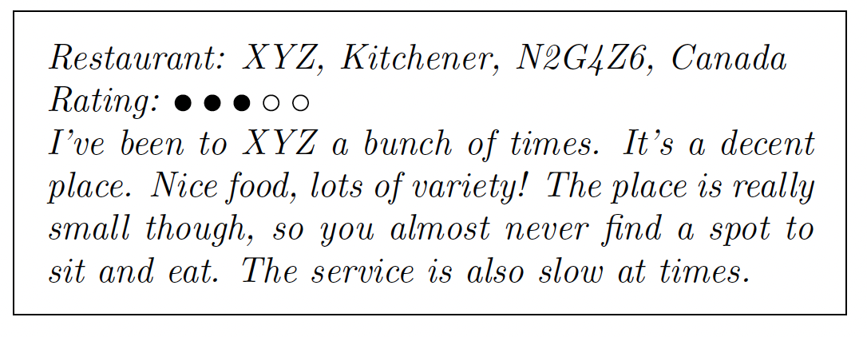
Overview and Goals
This project aims to predict restaurant review star ratings (1–5) from Yelp review text using text mining and machine learning.
Primary goal: Build a model that predicts star ratings from review text.
Secondary goals:
Compare feature extraction methods (n-grams, TF-IDF, embeddings).
Evaluate different model types (linear, tree-based, neural).
Address class imbalance and assess per-class performance.
Source: Yelp Dataset Challenge: Review Rating Prediction, Nabiha Asghar

Slide 3
Project Phases

Slide 4
Phase 1: Data Preparation
Dataset: Yelp Open Dataset (subset: specific state restaurant reviews).
Tasks:
Filter restaurant reviews.
Clean and normalize text (lowercasing, punctuation removal, stopword removal).
Derive auxiliary features (e.g., review length, punctuation counts).
Split data into training, validation, and test sets. (90% training, 10% test)
Output: Cleaned, balanced dataset ready for modeling.

Slide 5
Phase 2: Feature Engineering
Approaches:
Bag-of-Words with TF-IDF (unigrams, bigrams, trigrams).
Hashing Vectorizer for scalability.
Dimensionality reduction (SVD/LSI).
Contextual embeddings (BERT or similar).
Optional features: Sentiment scores, review metadata (“useful,” “cool” votes).
Goal: Identify which text representation captures rating-related patterns best.

Slide 6
Phase 3: Modeling
Baseline models: Logistic Regression, Naive Bayes, SVM.
Advanced models: Random Forest, Gradient Boosting, Neural Networks.
Special approaches:
Ordinal or regression-based models for ordered star ratings.
Ensemble or stacked models to combine strengths.
Goal: Compare model families and select top performers.

Slide 7
Phase 4: Evaluation
Validation: k-fold cross-validation on training data.
Metrics: Accuracy, RMSE, and macro-F1; per-class recall for minority ratings.
Analysis:
Confusion matrix to diagnose class confusion.
Feature importance or interpretability (keywords, SHAP values).
Test performance on held-out data.

Slide 8
Phase 5: Insights and Reporting
Deliverables:
Summary of best-performing model(s).
Key drivers of star ratings (important words, features).
Error analysis—where and why predictions fail.
Expected findings:
Contextual embeddings and ensembles outperform simple TF-IDF models.
2- and 3-star reviews remain hardest to classify due to overlapping language.

Slide 9
Expected Outcomes

Slide 10
Risks and Mitigations
Risks
Mitigations
Class imbalance (4-5 stars dominate)
Overfitting on noisy text
Ambiguity in mid range ratings
Computational Limits
Use class weighting or resampling
Cross-validation, regularization
Ambiguity in mid range ratings
Use sampling or efficient vectorizers

Slide 11
Expected Outcomes
Working text-to-rating prediction model achieving ~60–70% accuracy.
Comparative evaluation of feature and model choices.
Actionable insights into textual patterns behind customer satisfaction.

